Slide 1
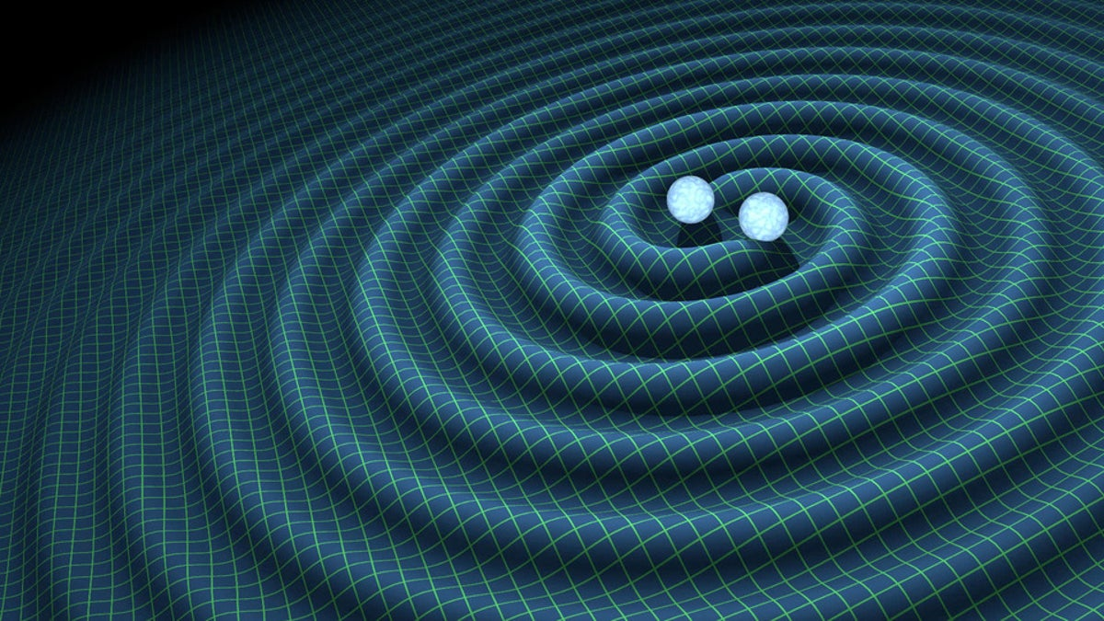
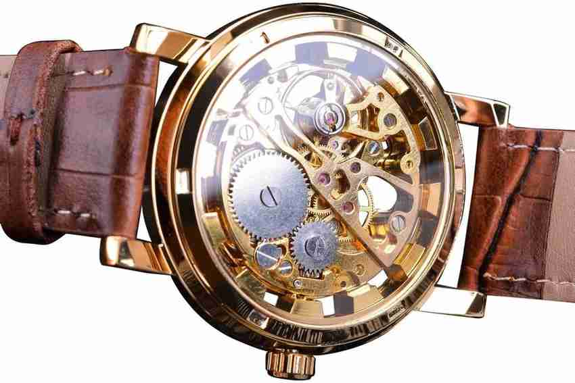
Clock Based Gravitational Wave Detection

Slide 2
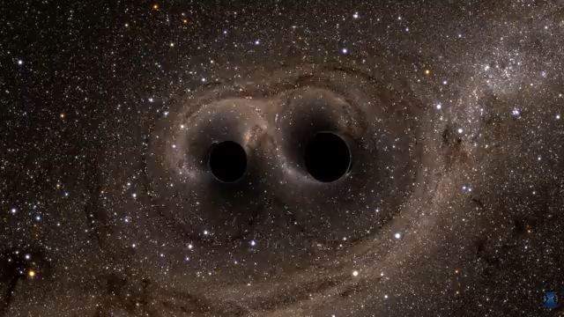
Gravitational Waves
Notes:
ripples in space-time propagating at the speed of light, most commonly associated with extreme gravity events like two black holes spiralling into each other

Slide 3
Basic Principle
Measuring GWs with Clocks

Slide 4

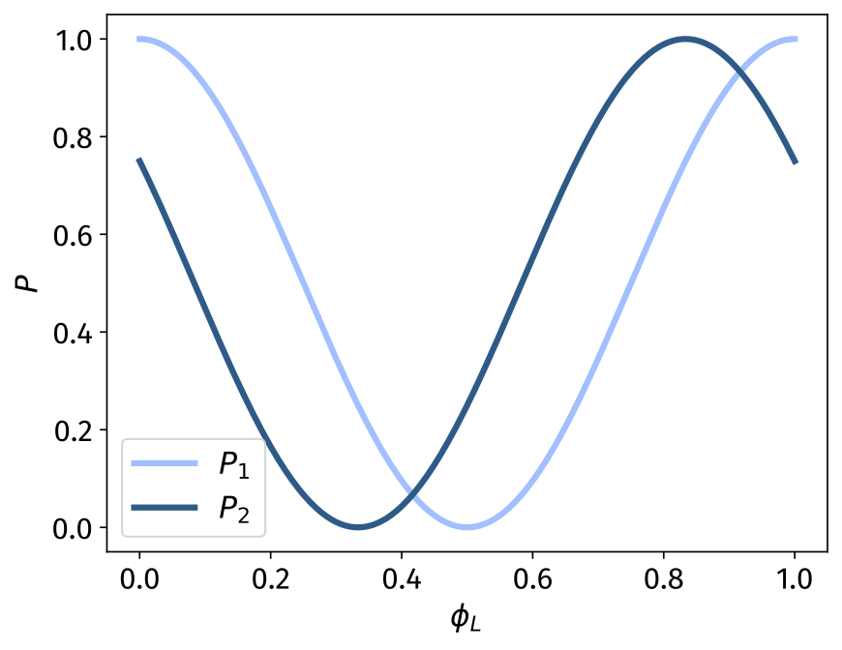
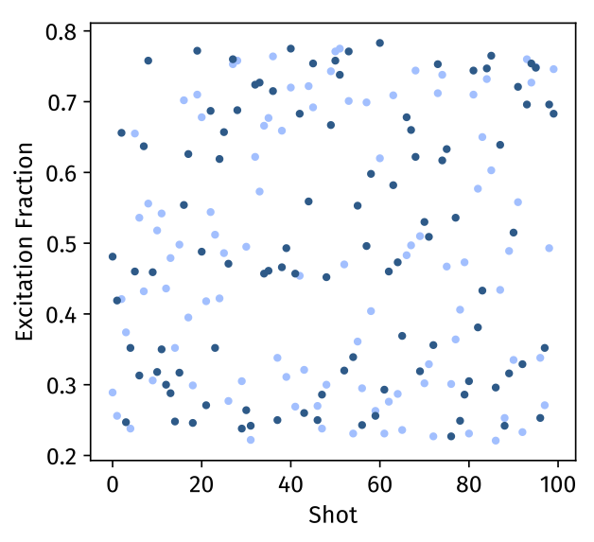
Differential measurements
813 nm lattice
Measurements beyond laser coherence time
698 nm clock laser

Slide 5
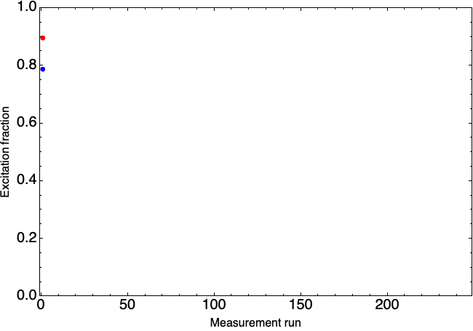
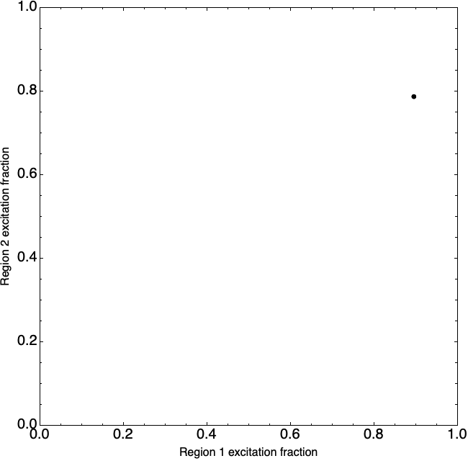
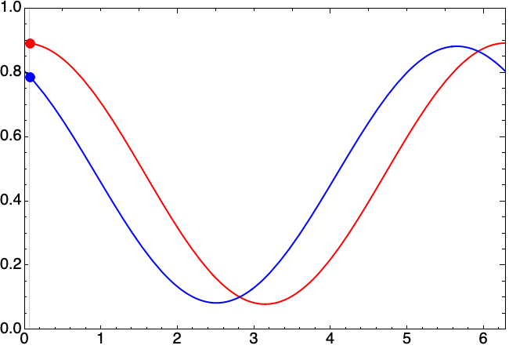
Differential measurements
animation: Shimon Kolkowitz

Slide 6
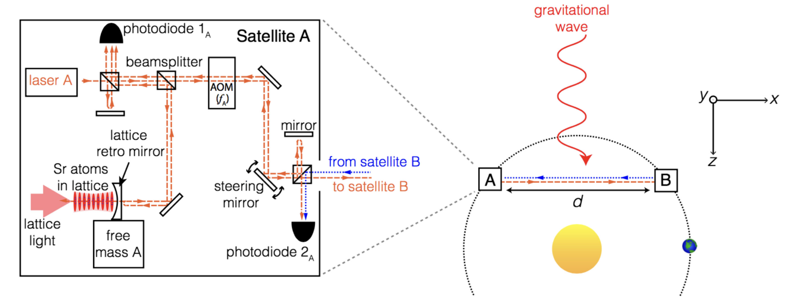
GW Detection
Kolkowitz et. al. PRD 2016

Slide 7
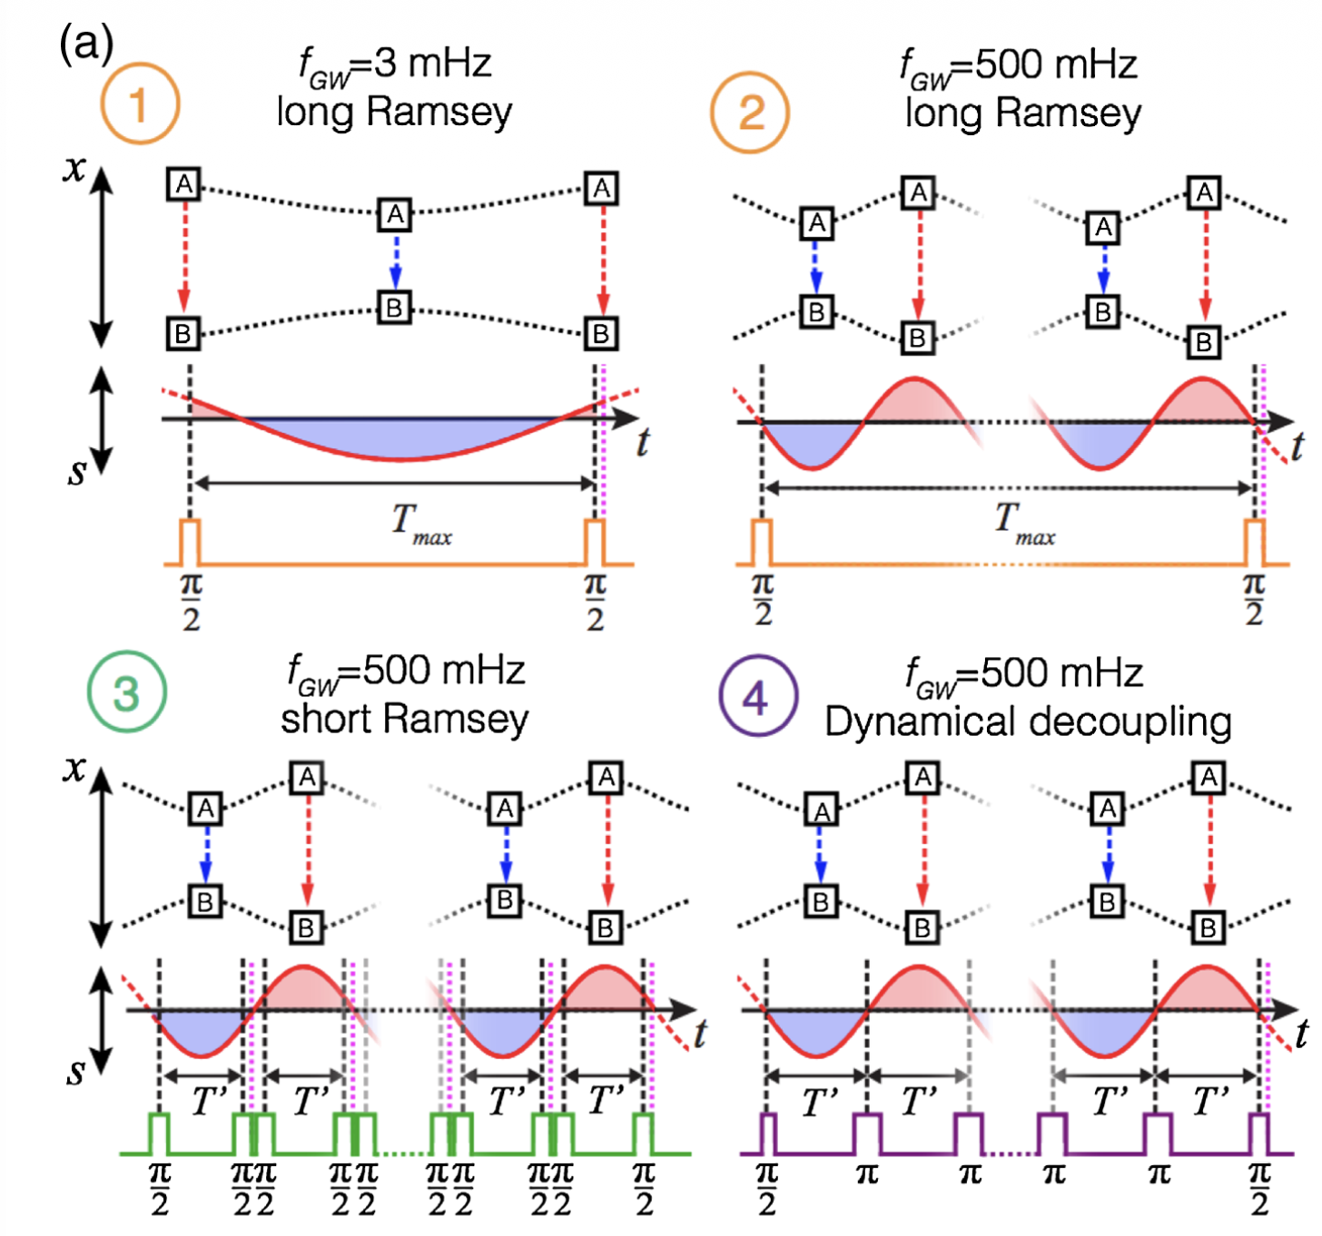
Doppler Tracking
Frequency difference due to the doppler shift induced by gravitational wave is averaged over measurement time
Dynamical Decoupling allows to add phase from every cycle by flipping the sign of the measured frequency
Kolkowitz et. al. PRD 2016

Slide 8
Signal strength
d = 10¹⁰ m

Slide 9
Detector Noise Sources
Quantum projection noise due to the binomial distribution of a finite number of atoms on measurement.
More atoms = Less Noise.
Averages down as 1/sqrt(t)
Residual laser noise from the control loop that locks the two lasers.
More photons = Less noise.
Averages down as 1/sqrt(t) when uncorrelated between measurements, 1/t when correlated

Slide 10
Measurement Protocols
Extracting useful information from signals

Slide 11
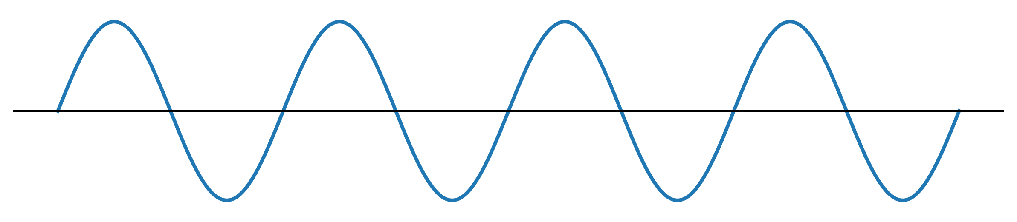
Monochromatic Signals
h(t)

Slide 12
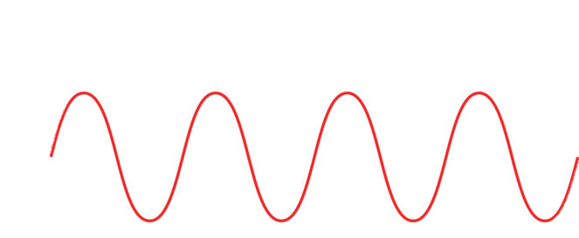
Frequency Estimation
N = 1e7
h =1e-20
Laser Noise : 1 mHz linewidth, 0.1 nW at PLL
T = 5s

Slide 13
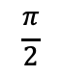
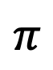
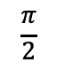
Phase/Amplitude Estimation
$$\frac{π}{2}$$
$$π$$
$$\frac{π}{2}$$
t₀

Slide 14
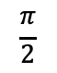
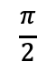
t₀
$$\frac{π}{2}$$
$$π$$
$$\frac{π}{2}$$
t

Slide 15
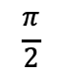
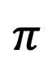
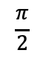
t₀
$$\frac{π}{2}$$
$$π$$
$$\frac{π}{2}$$

Slide 16
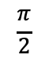
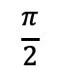
t₀
$$\frac{π}{2}$$
$$π$$
$$\frac{π}{2}$$

Slide 17
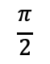
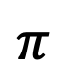
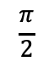
t₀
$$\frac{π}{2}$$
$$π$$
$$\frac{π}{2}$$

Slide 18
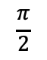
t₀
$$\frac{π}{2}$$
$$π$$
$$\frac{π}{2}$$

Slide 19
t₀

Slide 20
Phase/Amplitude Estimation
T = 160 s
f = 1/160 Hz
h = 1e-20
Measurement sequence = DD starting at different time points
No clear difference between more points vs more averages

Slide 22
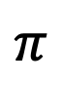
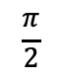
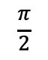
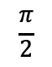
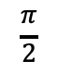
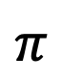
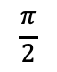
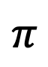
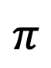
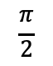
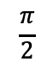
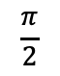
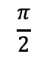
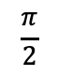
t₀
$$\frac{π}{2}$$
$$π$$
$$\frac{π}{2}$$
$$\frac{π}{2}$$
$$π$$
$$\frac{π}{2}$$
use multiple ensembles?
$$\frac{π}{2}$$
$$π$$
$$\frac{π}{2}$$
$$\frac{π}{2}$$
$$π$$
$$\frac{π}{2}$$
$$\frac{π}{2}$$
$$π$$
$$\frac{π}{2}$$

Slide 23
Estimated error smaller than true error at low averaging times (probably because of laser noise)

Slide 24
Astrophysics
Localization

Slide 25
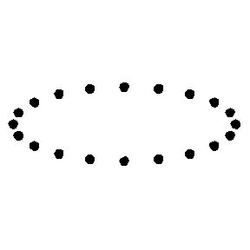
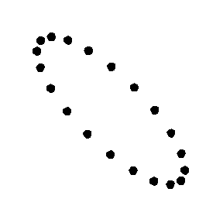
Geometry
L
+
ɩ
e’_{y}
Ψ
e’_{x}
e_{y}
z
e_{x}
+
θ
y
ɸ
x

Slide 26
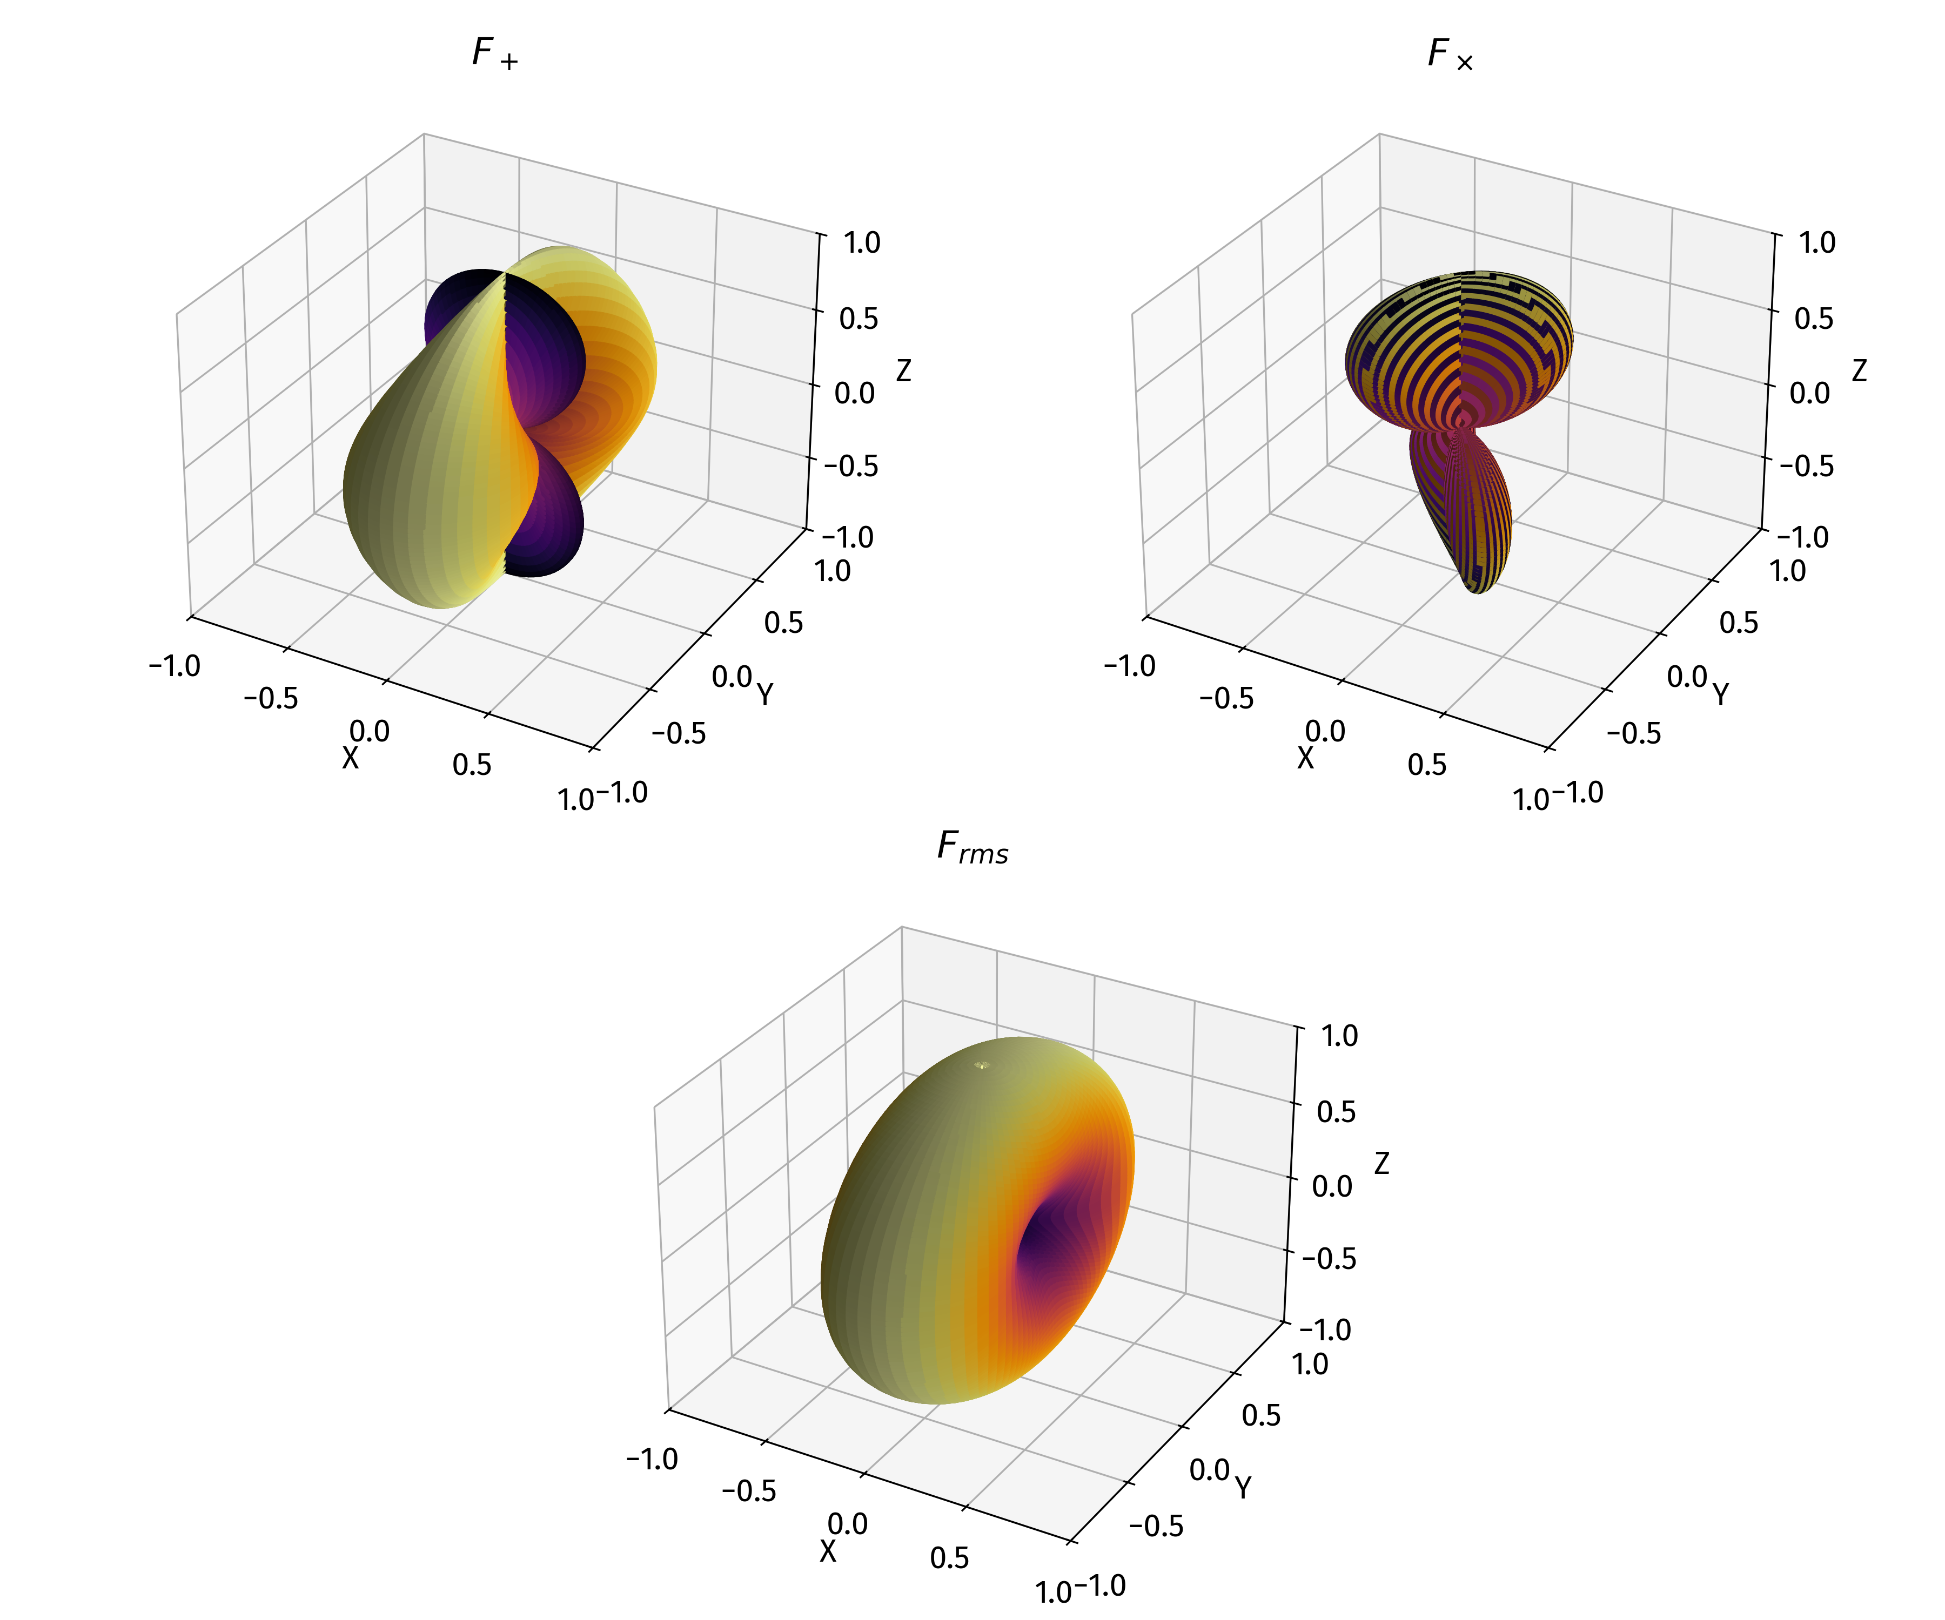
Antenna Patterns

Slide 27
First Attempts at Localization
Three detectors in heliocentric (circular) orbit @0, 30, 60 degree orientations.
Same noise floors, only assume + polarization with psi = 0 for the sake of simplicity

Slide 33
Chirping Signals?
Binary inspiral signals chirp in frequency.
Heavier binaries chirp faster.
Given the amount of averaging time we need, this limits the range of sources we can target

Slide 34
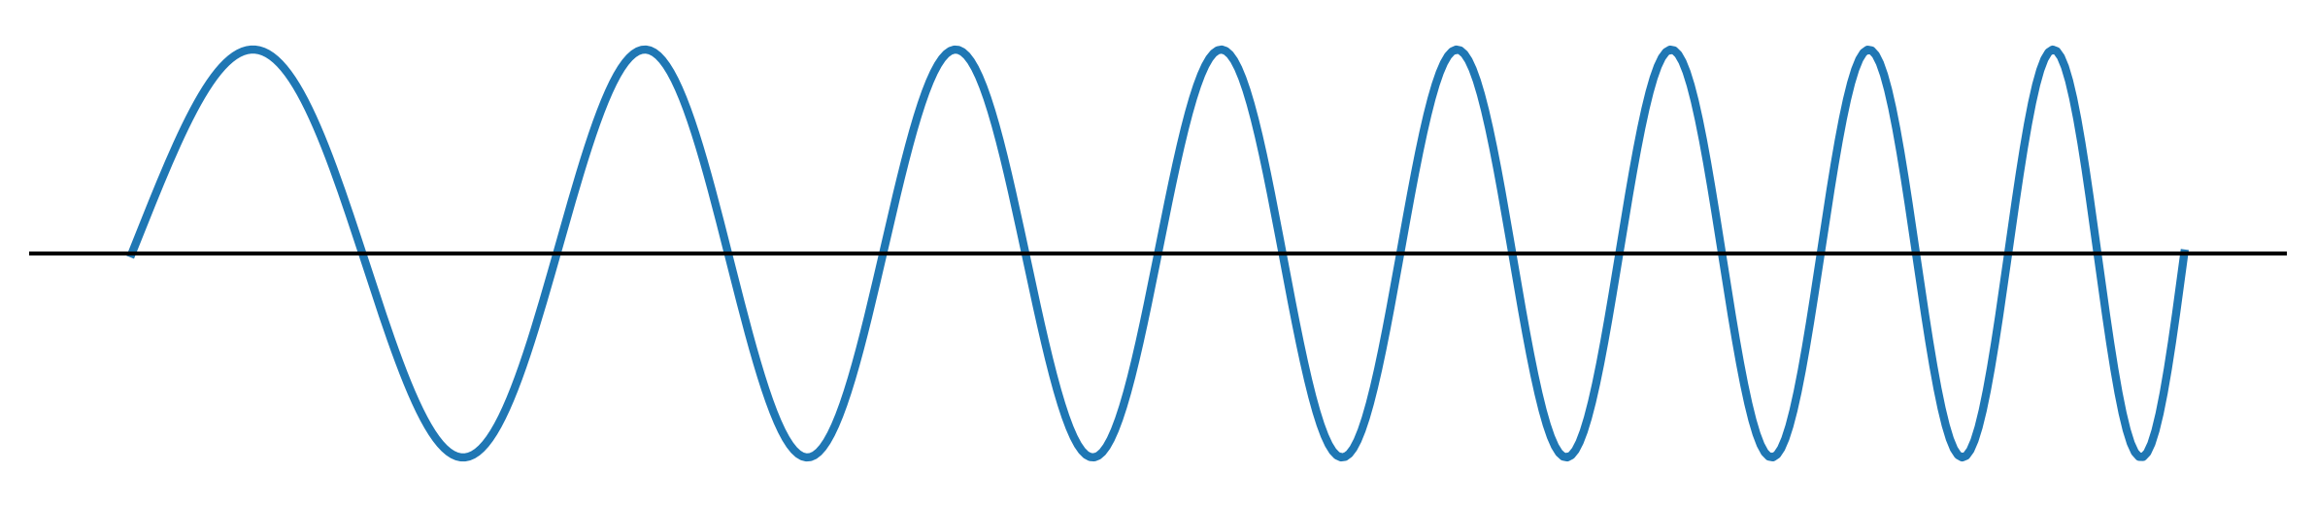
Ramsey on chirping signals

Slide 35
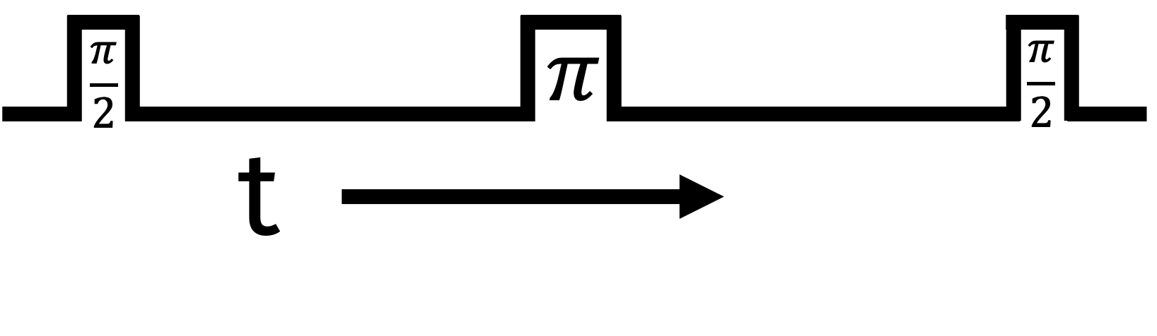
Ramsey on chirping signals
fixed T = 1/f(t₀)?
goes out of sync in no time

Slide 36
Ramsey on chirping signals
T = 1/f(t)?
better but also goes out of sync

Slide 37
Ramsey on chirping signals
Optimizing T requires knowledge of frequency evolution

Slide 38
Ramsey on chirping signals

Slide 39
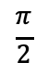
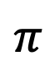
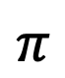
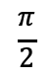
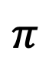
Ramsey on chirping signals
$$\frac{π}{2}$$
$$π$$
$$\frac{π}{2}$$
$$\frac{π}{2}$$
$$π$$
$$\frac{π}{2}$$
$$\frac{π}{2}$$
$$π$$
$$\frac{π}{2}$$

Slide 40

Science Cases
Early localization of terrestrial band sources before merger.

Slide 41

Science Cases
Fast localization of LISA band sources (heavy/intermediate mass black holes), outside of LIGO/3G band.

Slide 42

Science Cases
High redshift low mass black-holes (seeds for supermassive black holes). Redshifted to below terrestrial band.

Slide 43


Science Cases
Signatures of eccentricity/precession at early inspiral stages. Can select out higher order frequency components of signals.

Slide 44

Science Cases
Continuous waves : Slow spinning neutron stars. Not found. Do they exist????? Who knows????
Neutron star paleontology
Radio quiet 🤫

Slide 45
Open questions!
Can we achieve the laser noise requirements? Optimal controls problem
What if we don’t exactly know how a signal is evolving?? Any cool clock techniques available to us?
Need to figure out localization for general sources. Current analysis only with + polarized sources.

Slide 46
Thank you

Slide 47



Atomic clocks

Slide 48




Ramsey interferometry
T
If laser is coherent over time T, we get clean Ramsey fringes
Used for ultra-low frequency feedback to clock laser
Longer T = better frequency sensitivity

Slide 49

Typical clock operation
Optical frequency combs used to down-convert optical to microwave frequencies
S. A. Diddams et al Science 293,825-828(2001)

Slide 50
Differential clock comparisons with ⁸⁷Sr

Slide 51


Sr term diagram
In order to use ⁸⁷Sr as an optical clock, we need an extremely stable 698 nm laser. The coherence time of the laser sets an upper limit to Ramsey interrogation
doubly forbidden transition, weakly allowed through nuclear spin in ⁸⁷Sr
Bowden, W., Hobson, R., Hill, I.R. et al., 2019
Current state of the art from Jun Ye’s group at JILA ~ 30 mHz

Slide 52
Measurement offset largely inconsequential

